Slide 1
Generative AI
A Quick Overview of GenAI

Slide 2
What you will learn?
What is Generative AI?
Why Generative AI Booming?
Where Generative AI Exists?
Discriminative vs Generative AI
What is LLMs?
Domain based Applications of Generative AI

Slide 3
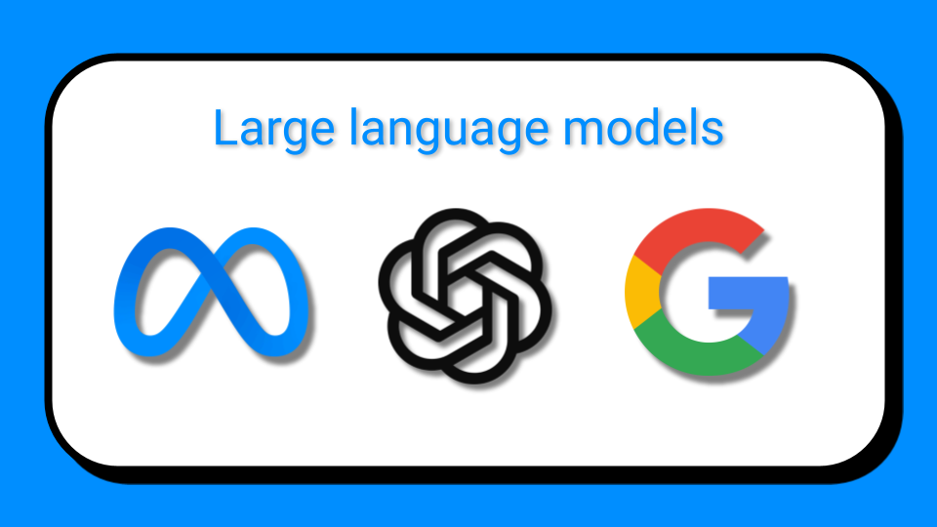
Generative AI
ChatGPT
Google Bard
Meta Llama 2
Perplexity
Claude

Slide 4
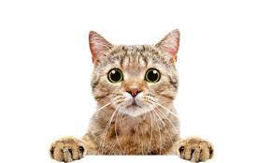
Generative Model
Questions
Responses

Slide 5
What is Generative AI?
Generative AI generate new data based on training sample. Generative model can generate Image, Text, Audio, Videos etc data as output.
Generative Model you can divide into two major segment
Generative unimodal
Generative Multimodal

Slide 6
Why is Generative AI Booming
Transforming creativity and automation.
Increased Investment and Research
Applications across various industries

Slide 7
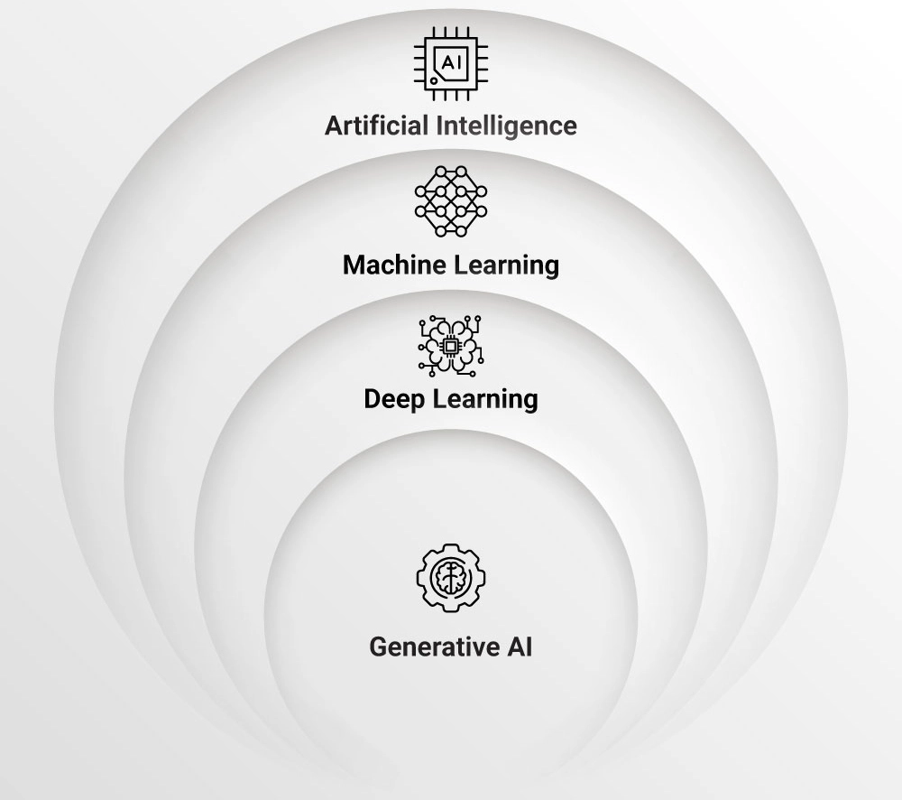
Where Generative AI Exists
Machine Learning is the subset of Artificial Intelligence
Deep Learning is the subset of Machine Learning
Generative AI is the subset of Deep Learning

Slide 8
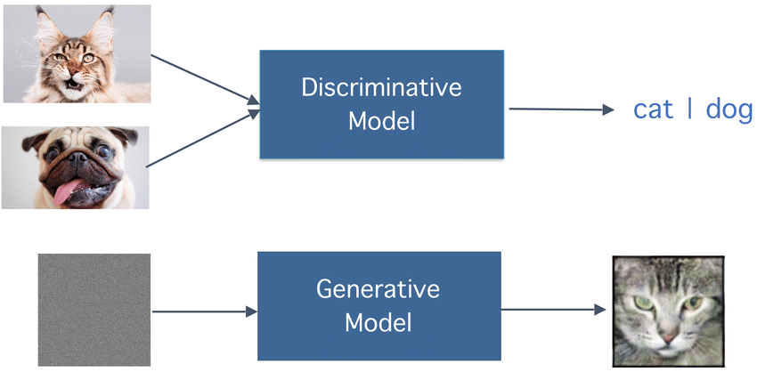
Discriminative vs Generative Model

Slide 9
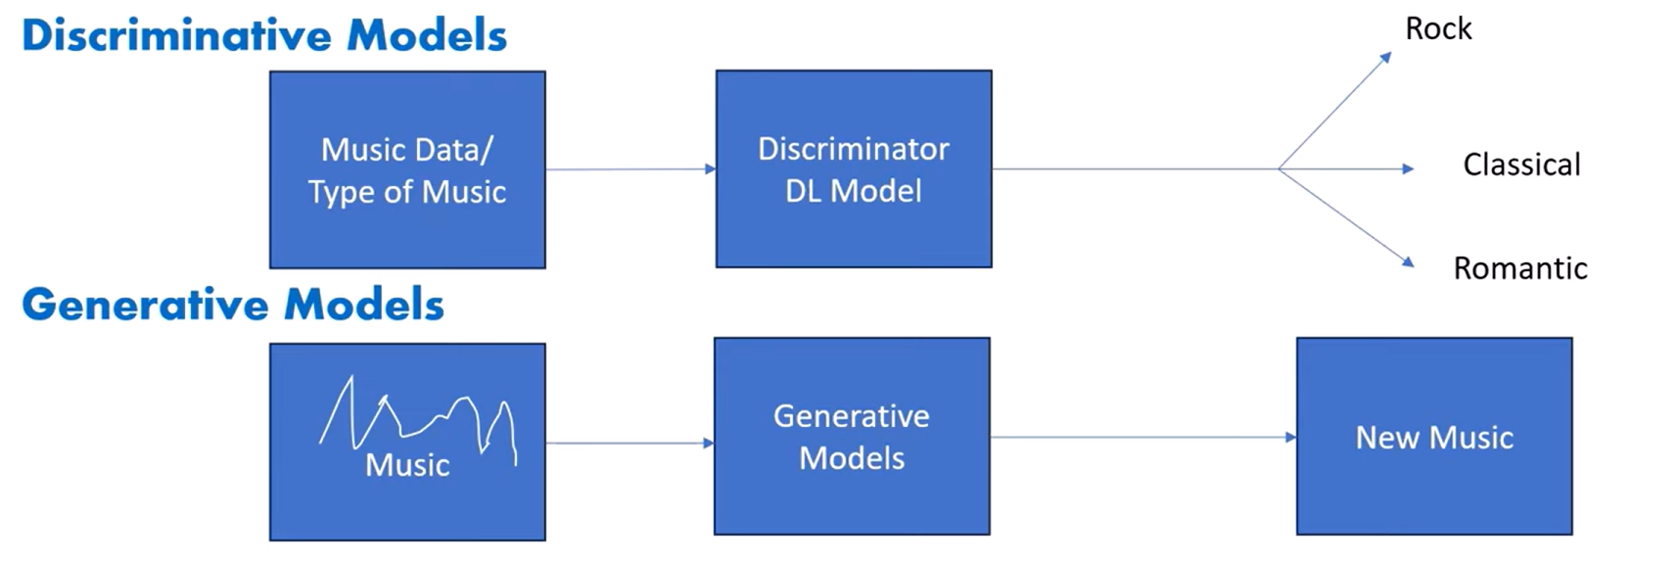
Discriminative vs Generative Model

Slide 10
What is LLMs?
Large Language Models (LLMs) are foundational that use deep learning models like transformer to process and understand natural. These models are trained on massive amounts of text data to learn patterns and entity relationships in the language.
It is a language model which is responsible for performing task such as text to text generation , text to image generation , image to text generations and image to image generation.

Slide 11
Application Areas
Text Generation
Chatbots, story generation, summarization.
Image Generation:
DALL-E, Stable Diffusion, MidJourney.
Music and Audio:
Tools like OpenAI Jukebox.
Video Synthesis and Animation:
Applications like Deepfake creation, editing and Video Summarization.

Slide 12
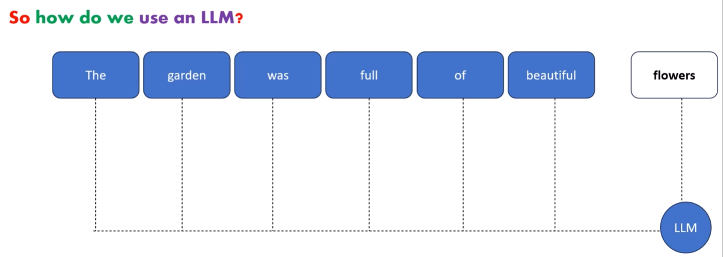
What is LLMs?
A large Language model is a trained deep learning model (Transformers) that understands and generate text in a human like fashion.
LLMs are good at Understanding and generating human language

Slide 13
Why we call it Large Language Model?
Because of the size and complexity of the Neural Network as well as the size of the dataset that it was trained on.
Researchers started to make these models large and trained on huge datasets
That they started showing impressive results like understanding complex Natural Language and generating language more eloquently than ever.

Slide 14
What LLMs Powerful?
In case of LLM, one model can be used for a whole variety of tasks like:-
generation, summarizer, translation, classification
& so on …
And now it has Multimodal capability also.

Slide 15
Generative Models
GANs (Generative Adversarial Networks):
Basic architecture: Generator aur Discriminator.
Common GAN types: DCGAN, CycleGAN, StyleGAN.
VAEs (Variational Autoencoders):
Encoding/Decoding and latent variable modeling.
Transformers in Generation:
GPT series, BERT for masked token generation.
Applications in text generation.

Slide 16
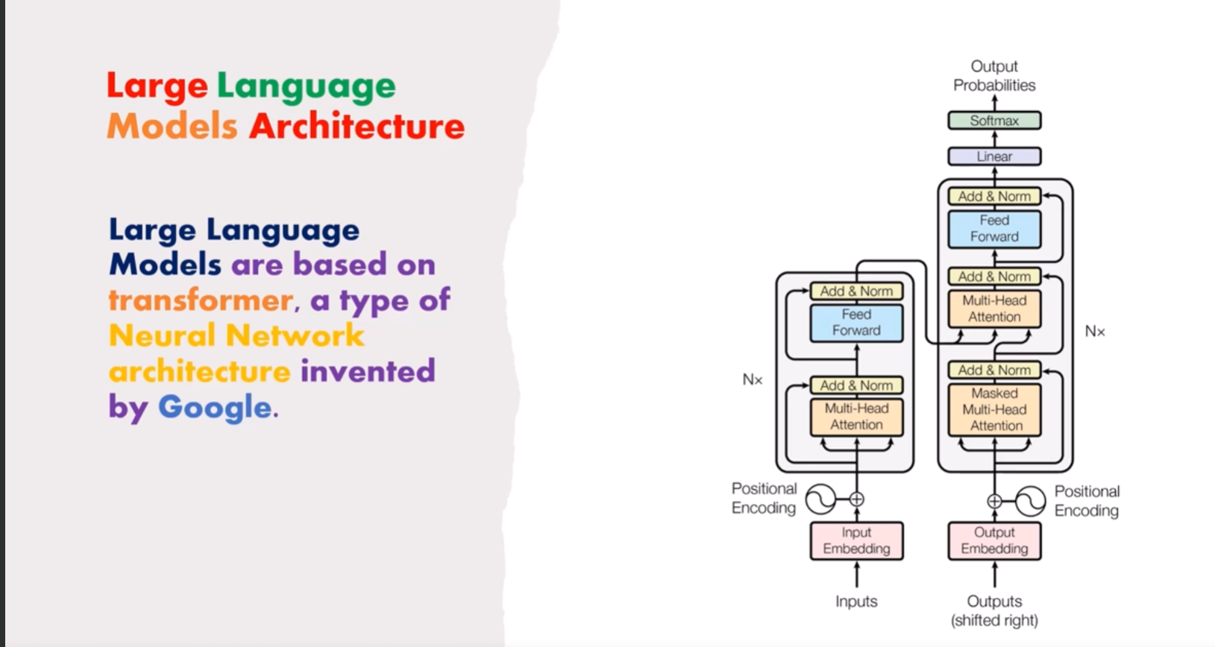
Transformers: Architecture Behind LLMs
Large Language models are based on transformer a type of Neural Network
Architecture invented by Google.

Slide 17
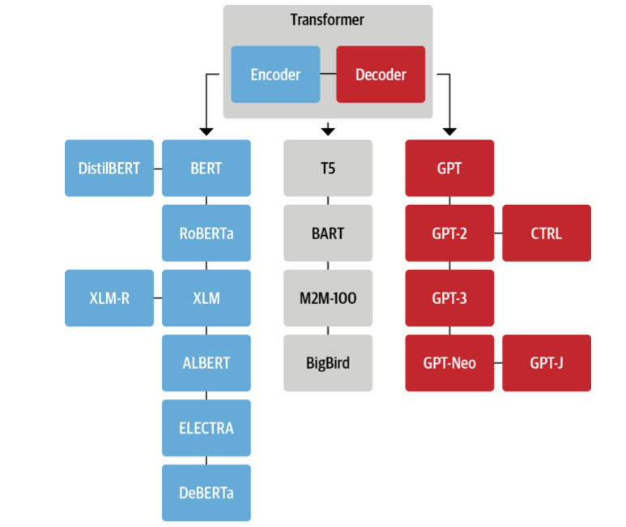
Transformer Tree

Slide 18
Few initial milestone in LLMs
BERT: Bidirectional Encoder Representations from Transformers (BERT) was developed by Google
GPT: GPT stands for "Generative Pre-trained Transformer". The model was developed by OpenAI
XLM: Cross-lingual Language Model Pretraining by Guillaume Lample, Alexis Conneau.
T5: The Text-to-Text Transfer Transformer It was created by Google AI
Megatron: Megatron is a large, powerful transformer developed by the Applied Deep Learning Research team at NVIDIA
M2M-100: multilingual encoder-decoder (seq-to-seq) model researchers at Facebook

Slide 19
Famous large language models
Meta Llama
Mistral AI
Google Gemini
Anthropic Claude
OpenAI GPTs
Nvidia AI

Slide 20
Famous Open-Source Models
BLOOM
Llama 2
PaLM
Falcon
Claude
MPT-30B
Stablelm
Flan T5

Slide 21
What is a multimodal Transformer
Multimodal transformer models extend the transformer architecture to incorporate other modalities, such as images and audio. These models have achieved state-of-the-art performance on various multimodal tasks, including visual question answering, image captioning, and speech recognition.

Slide 22
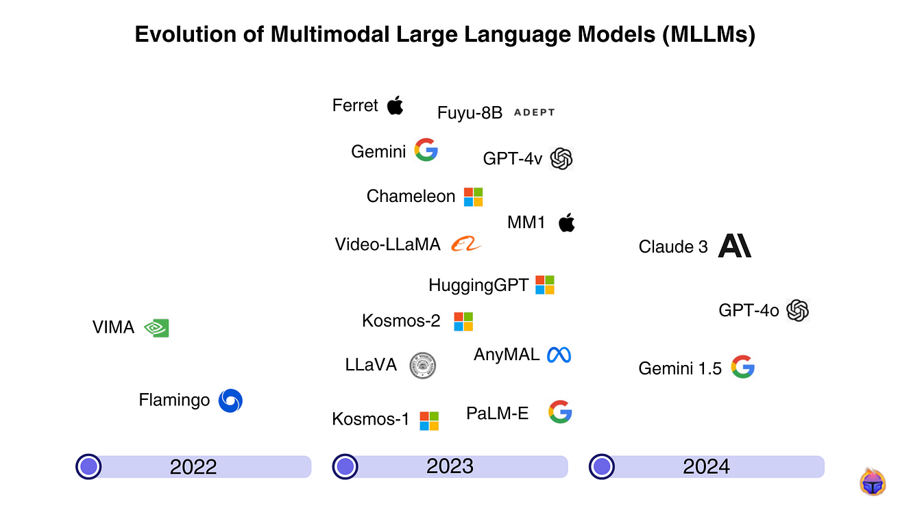

Slide 23
Multimodal Capable Model
LLaVA : Research at Microsoft
Vision Transformer(ViT): Google Research, Brain Team
Qwen-VL : Alibaba
Claude 3.5 Sonnet: Claude
GPT-4v, 4o, Sora, DALL-E : OpenAI
Stable Diffusion: Stability AI
CLIP (Contrastive Language–Image Pre-training): OpenAI
Google Gemini 1.5
Runway Gen-2

Slide 24
How ChatGPT was trained?
ChatGPT is a complete software which is using LLM GPT-3.5 Turbo, GPT-4 and GPT-4o. It has trained on an immense amount of data available all over the internet.
Generative pre-training
Supervised fine-tuning
Reinforcement learning

Slide 25
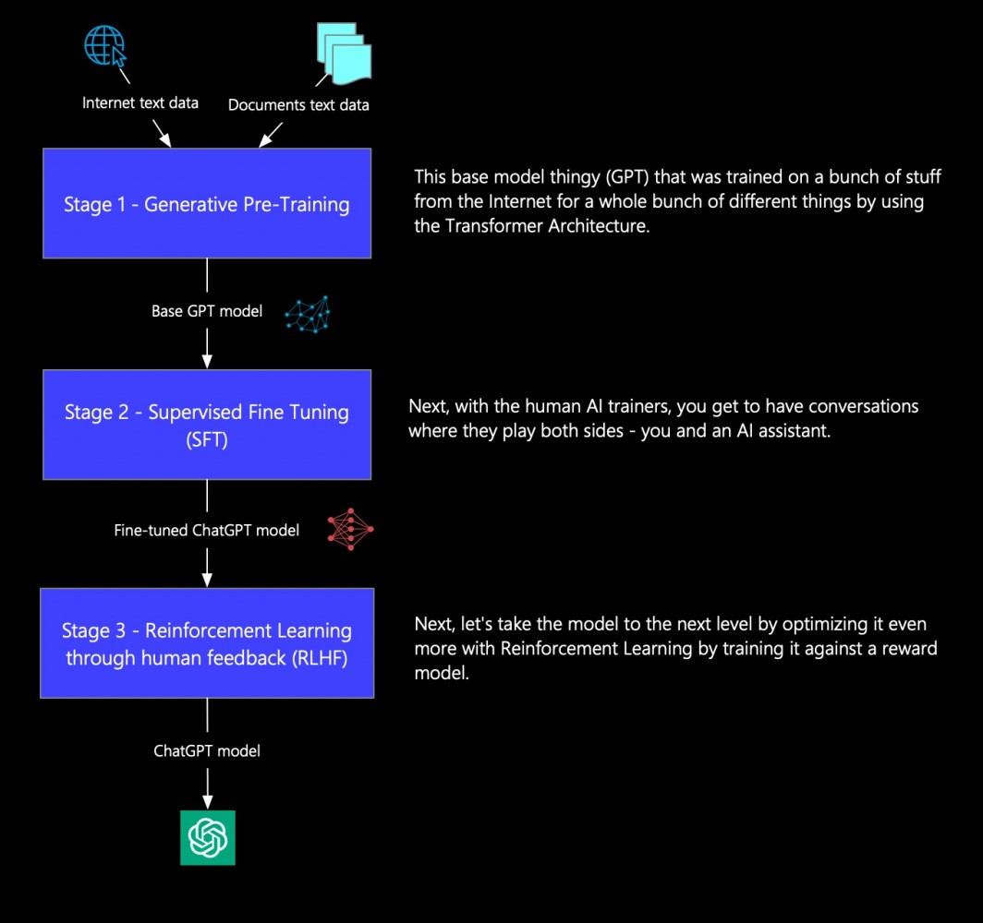

Slide 26
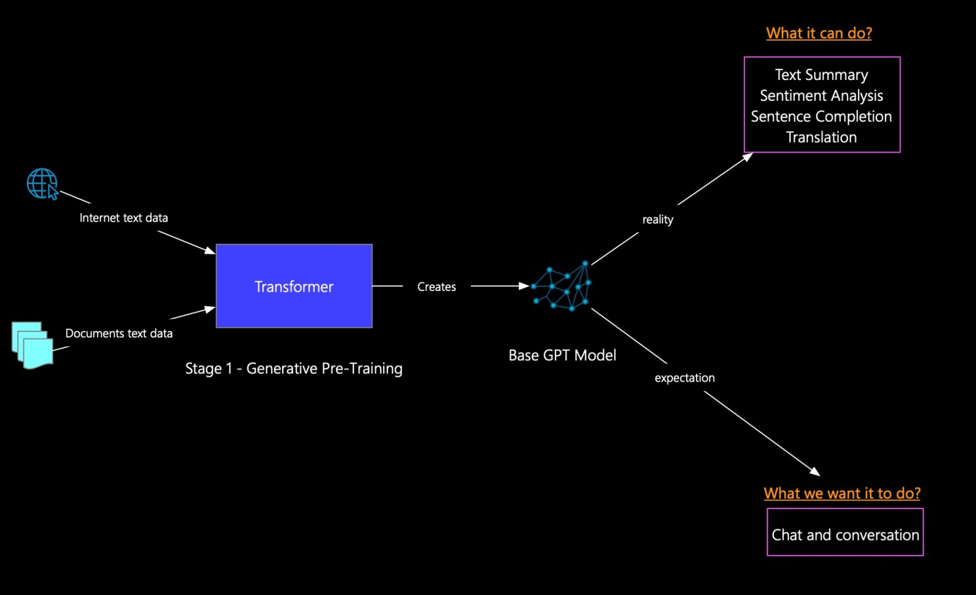
Generative Pre-Training

Slide 27
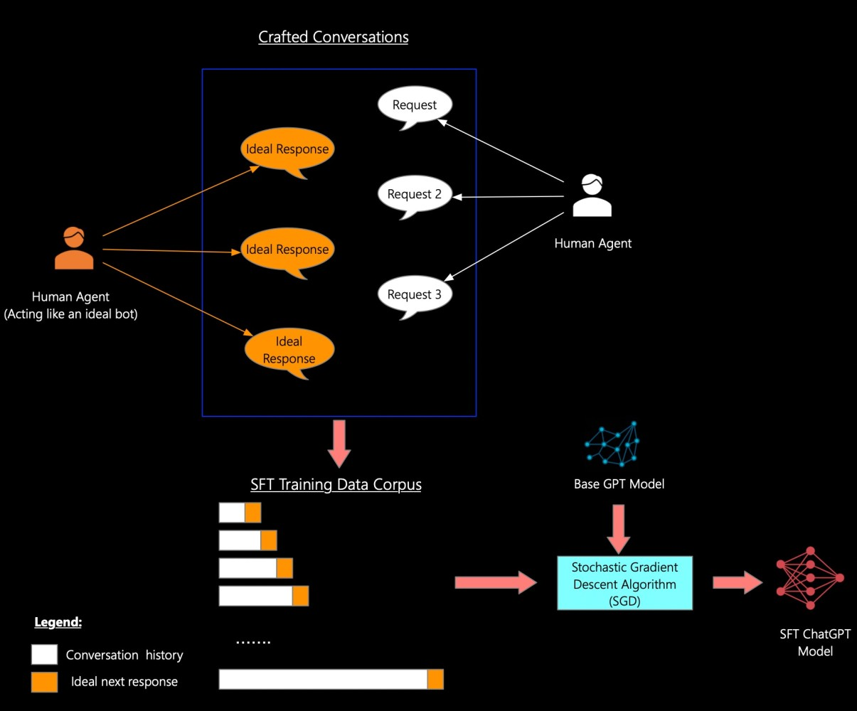
Supervised Fine-Tuning (SFT)

Slide 28
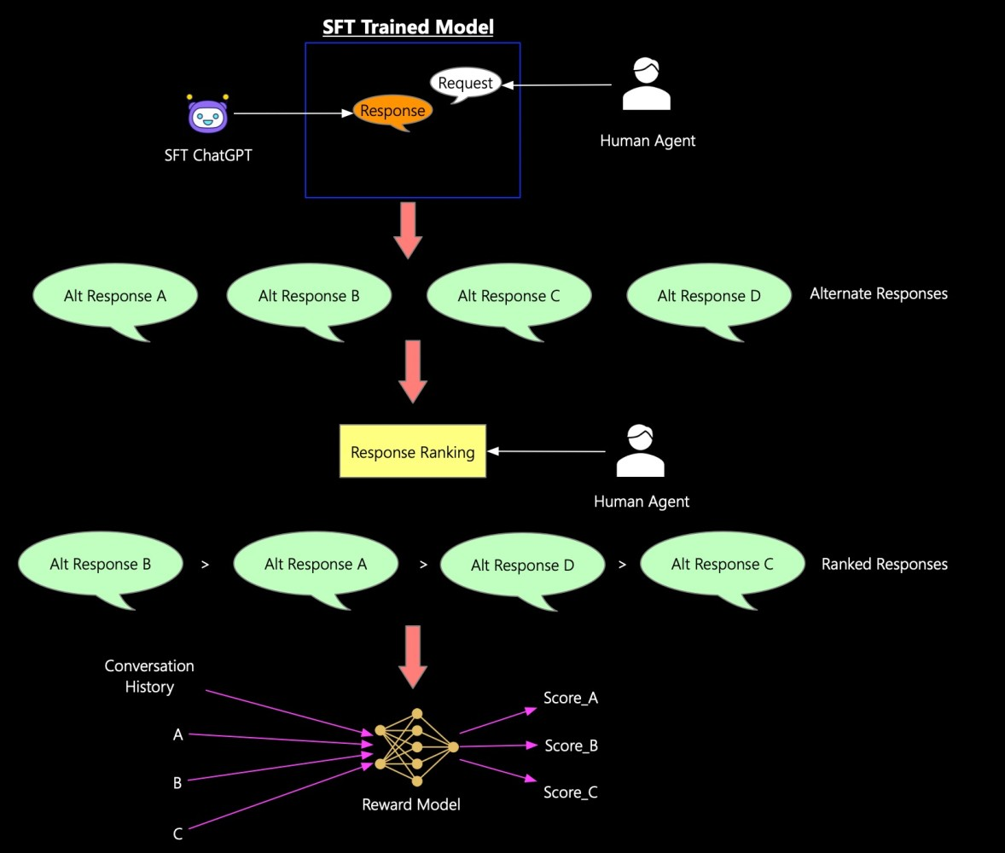
Reinforcement Learning through Human Feedback (RLHF)

Slide 29
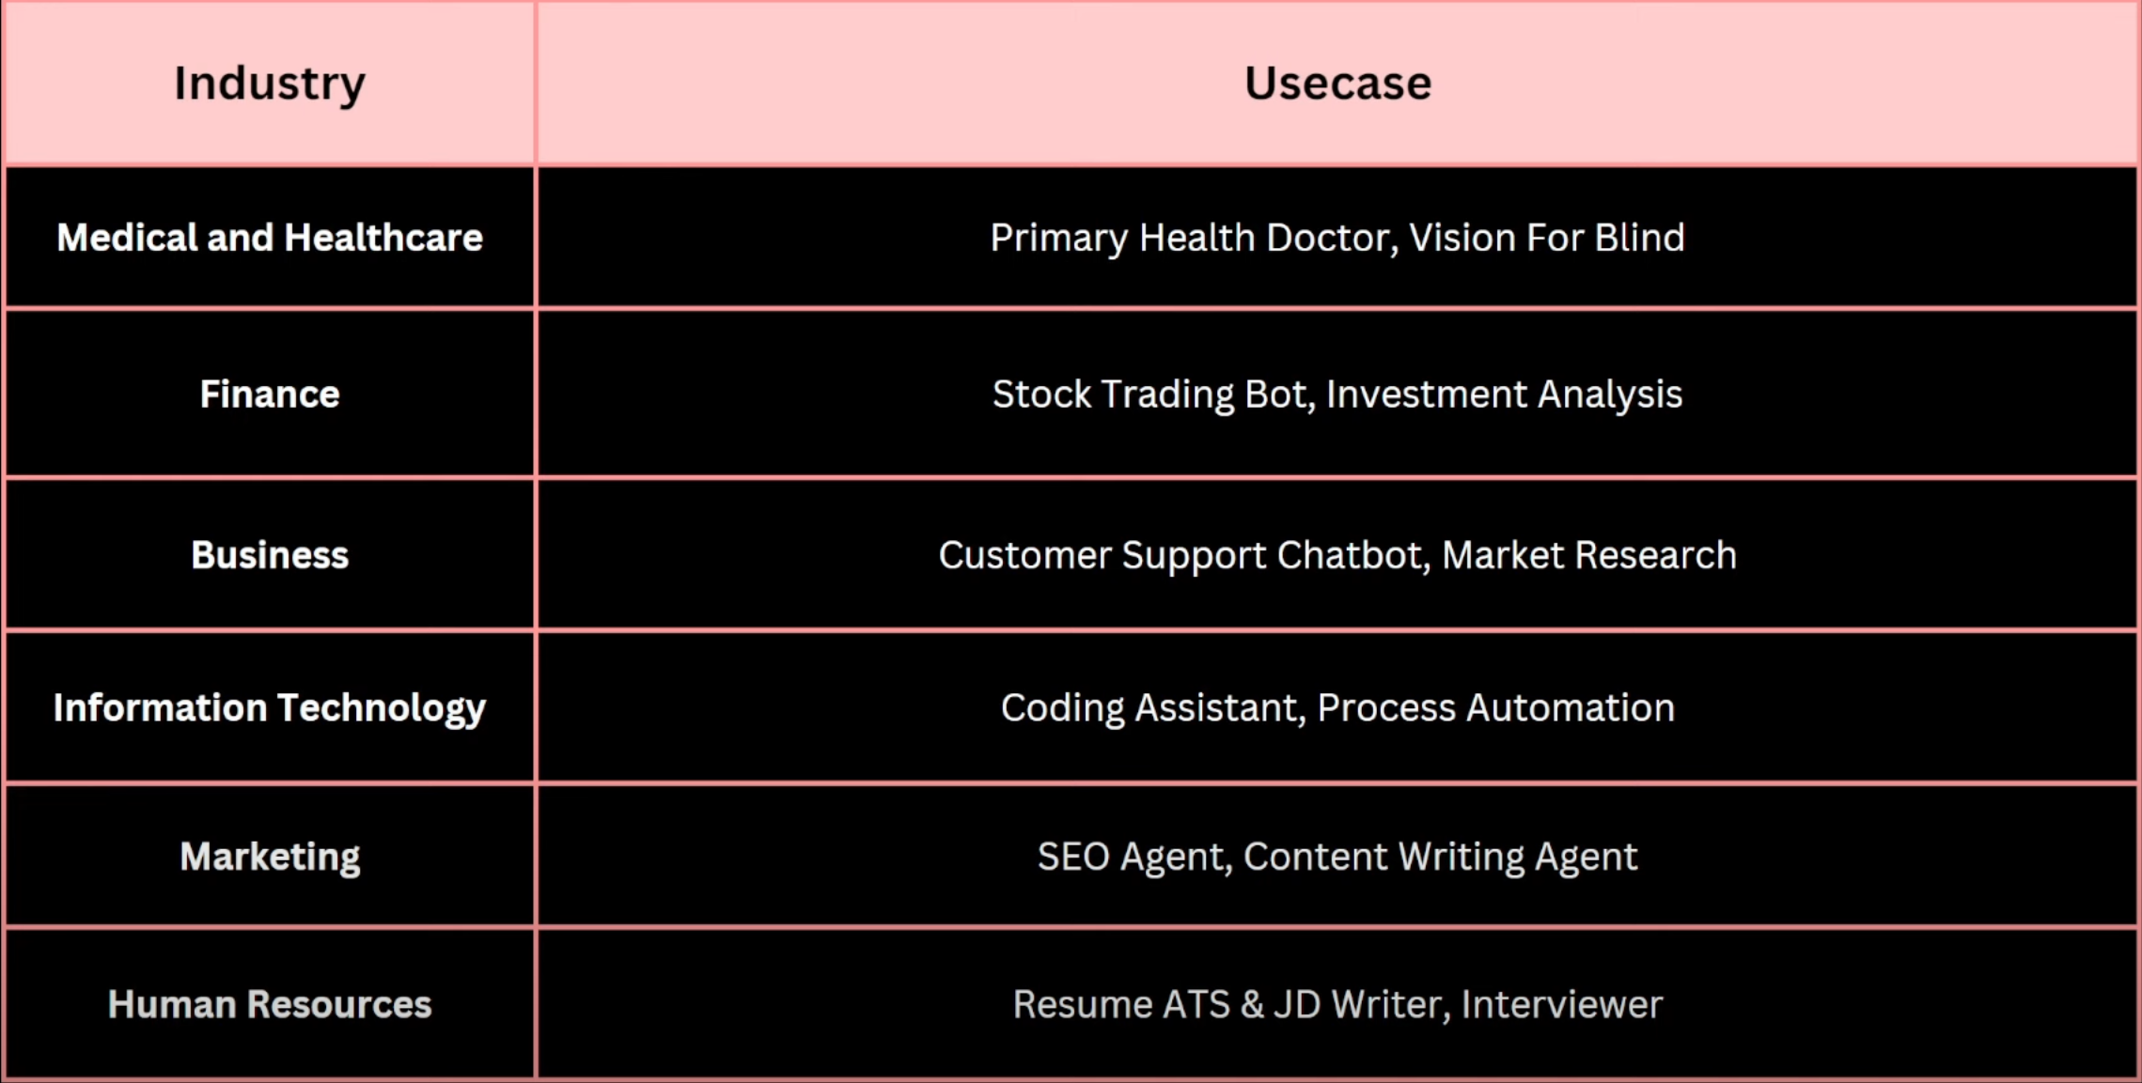

Slide 30
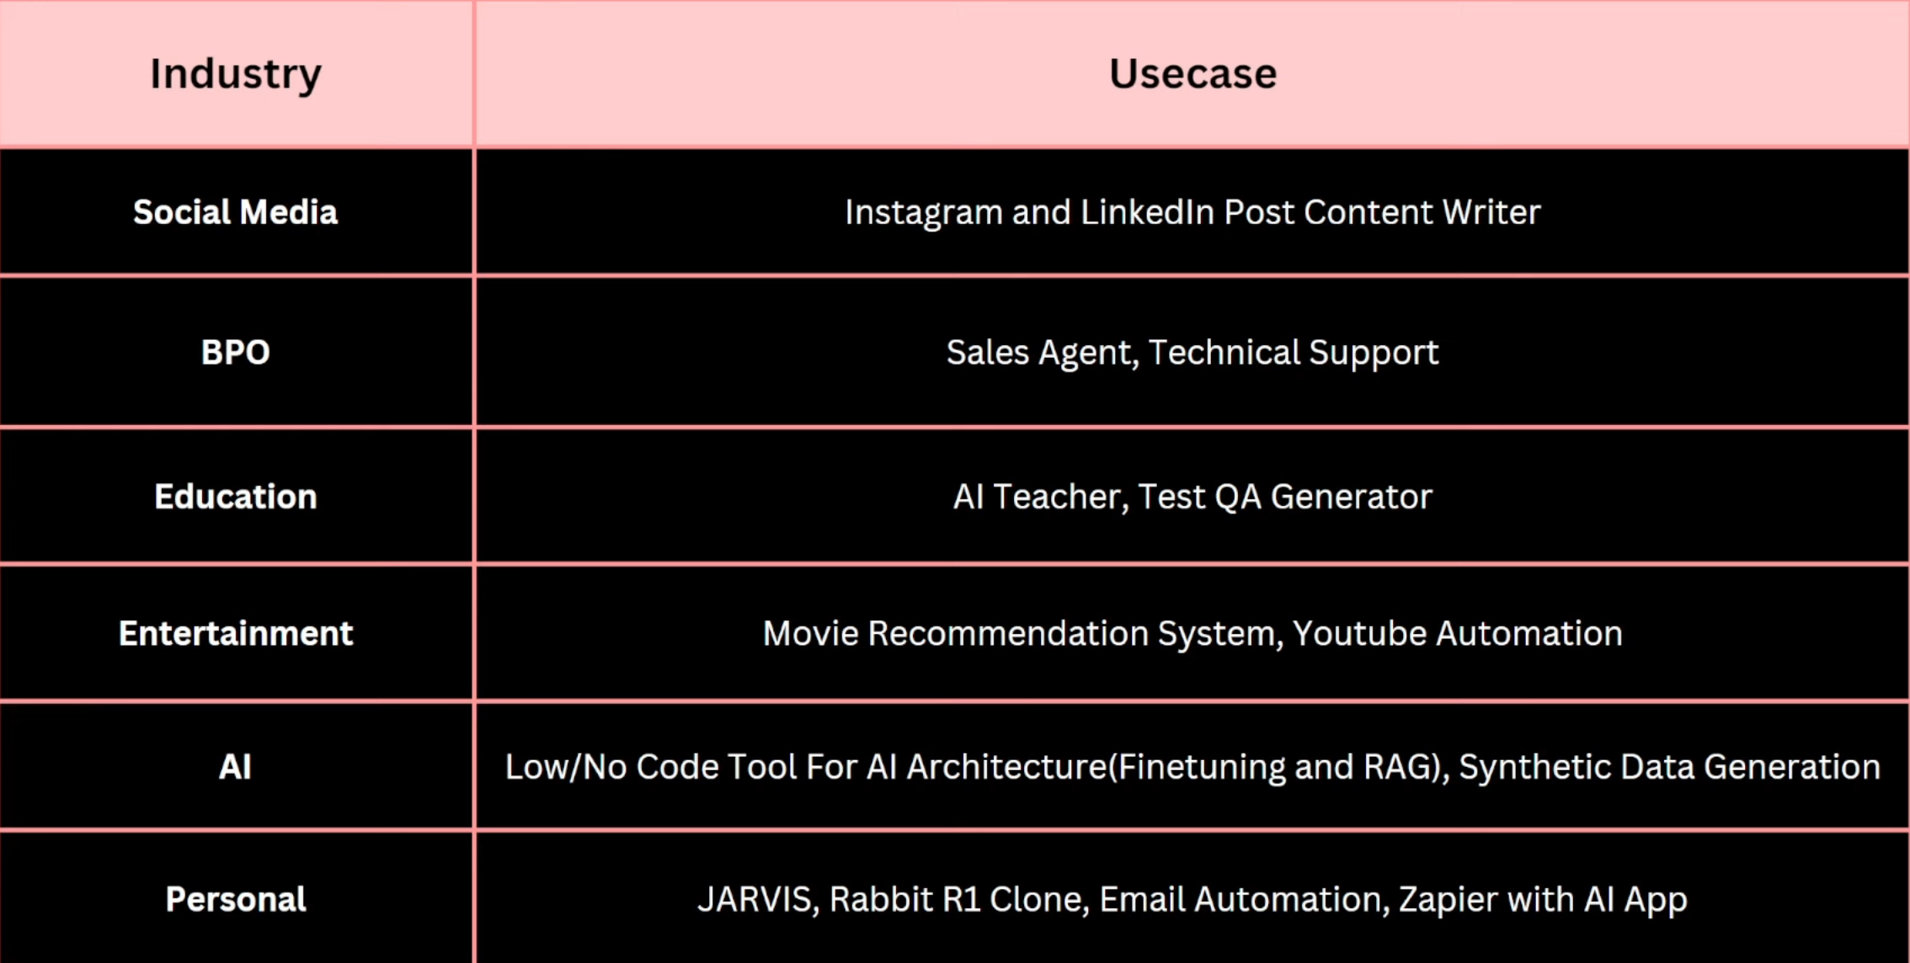

Slide 31
Thank You!

